Slide 1

Company Profile
Certified by AFPI
Trusted & Professional Collection Agency

Slide 2

CONTENTS
Who we are?
Technology
Strategy
Services
Our Office

Slide 3

01 Who we are?
Debito is one of the Certified
collection agency by AFPI

Slide 4
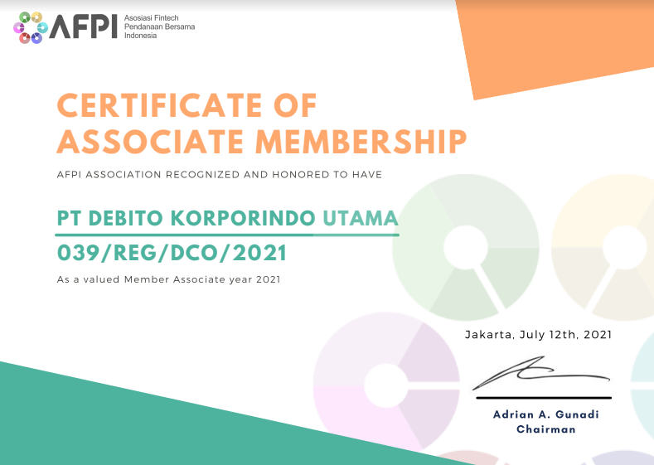
A legal company with full registration by AFPI
With this Certificate:
We are fully followed AFPI Code of Conduct and we can assure will not have any compliance problems in the future

Slide 5


A legal company with Certified Agent
Agent Certification :
We are Have more than 100% Desk Collection Agent Who get APFI Certificate

Slide 6
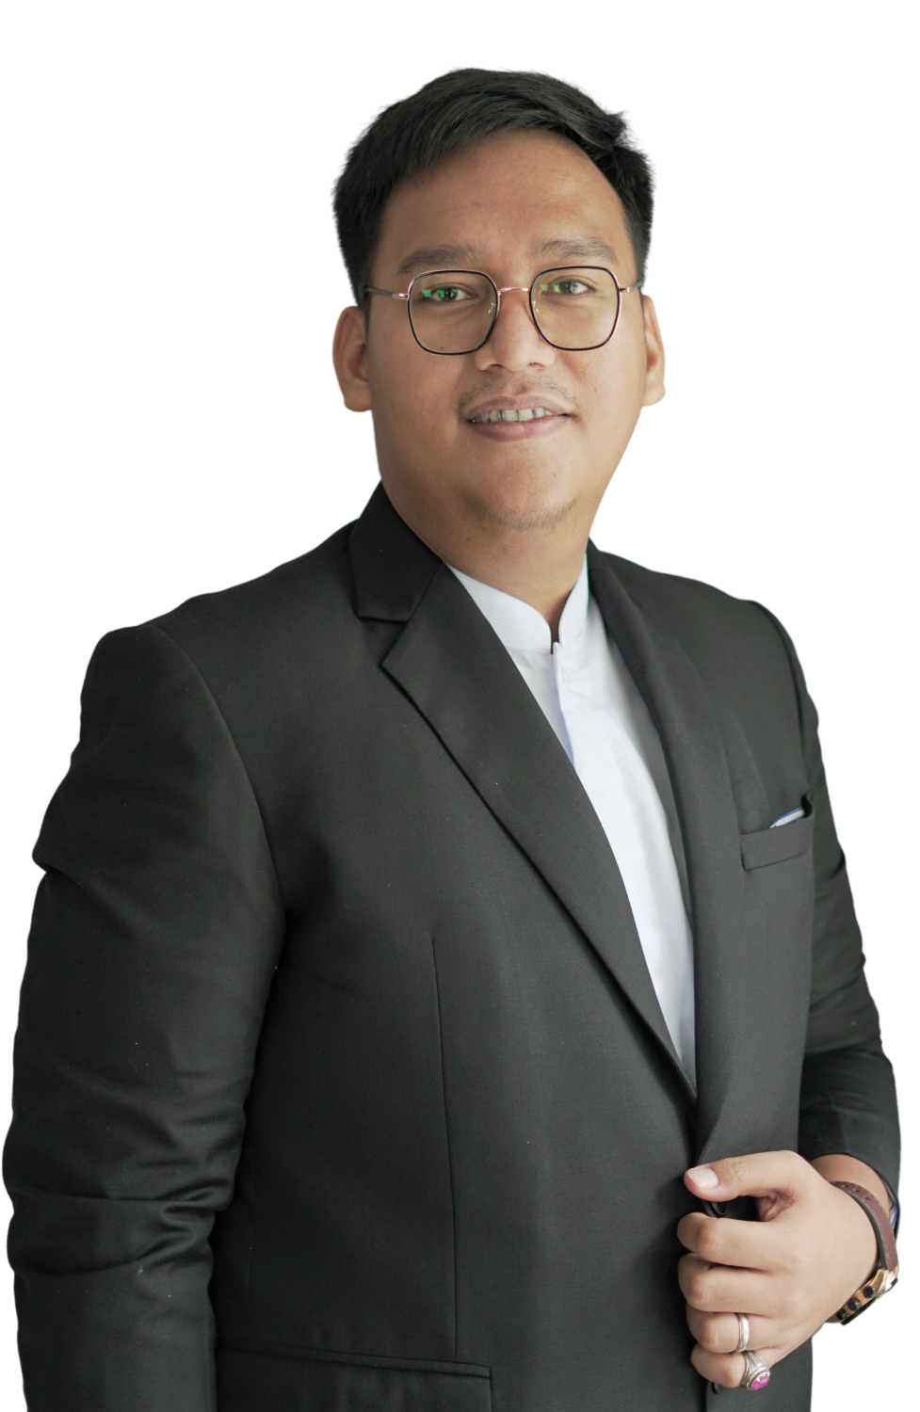
Our Director
Riza Ummara El Darman S.Pd.Ing
“Graduated from Universitas Negeri Padang majoring English Education at 2014, Riza has already multiple years on Operations field in financial industries. With his experience as head of collection for multiple years, Riza founded Debito and directly manage Debito’s professional teams. “

Slide 7
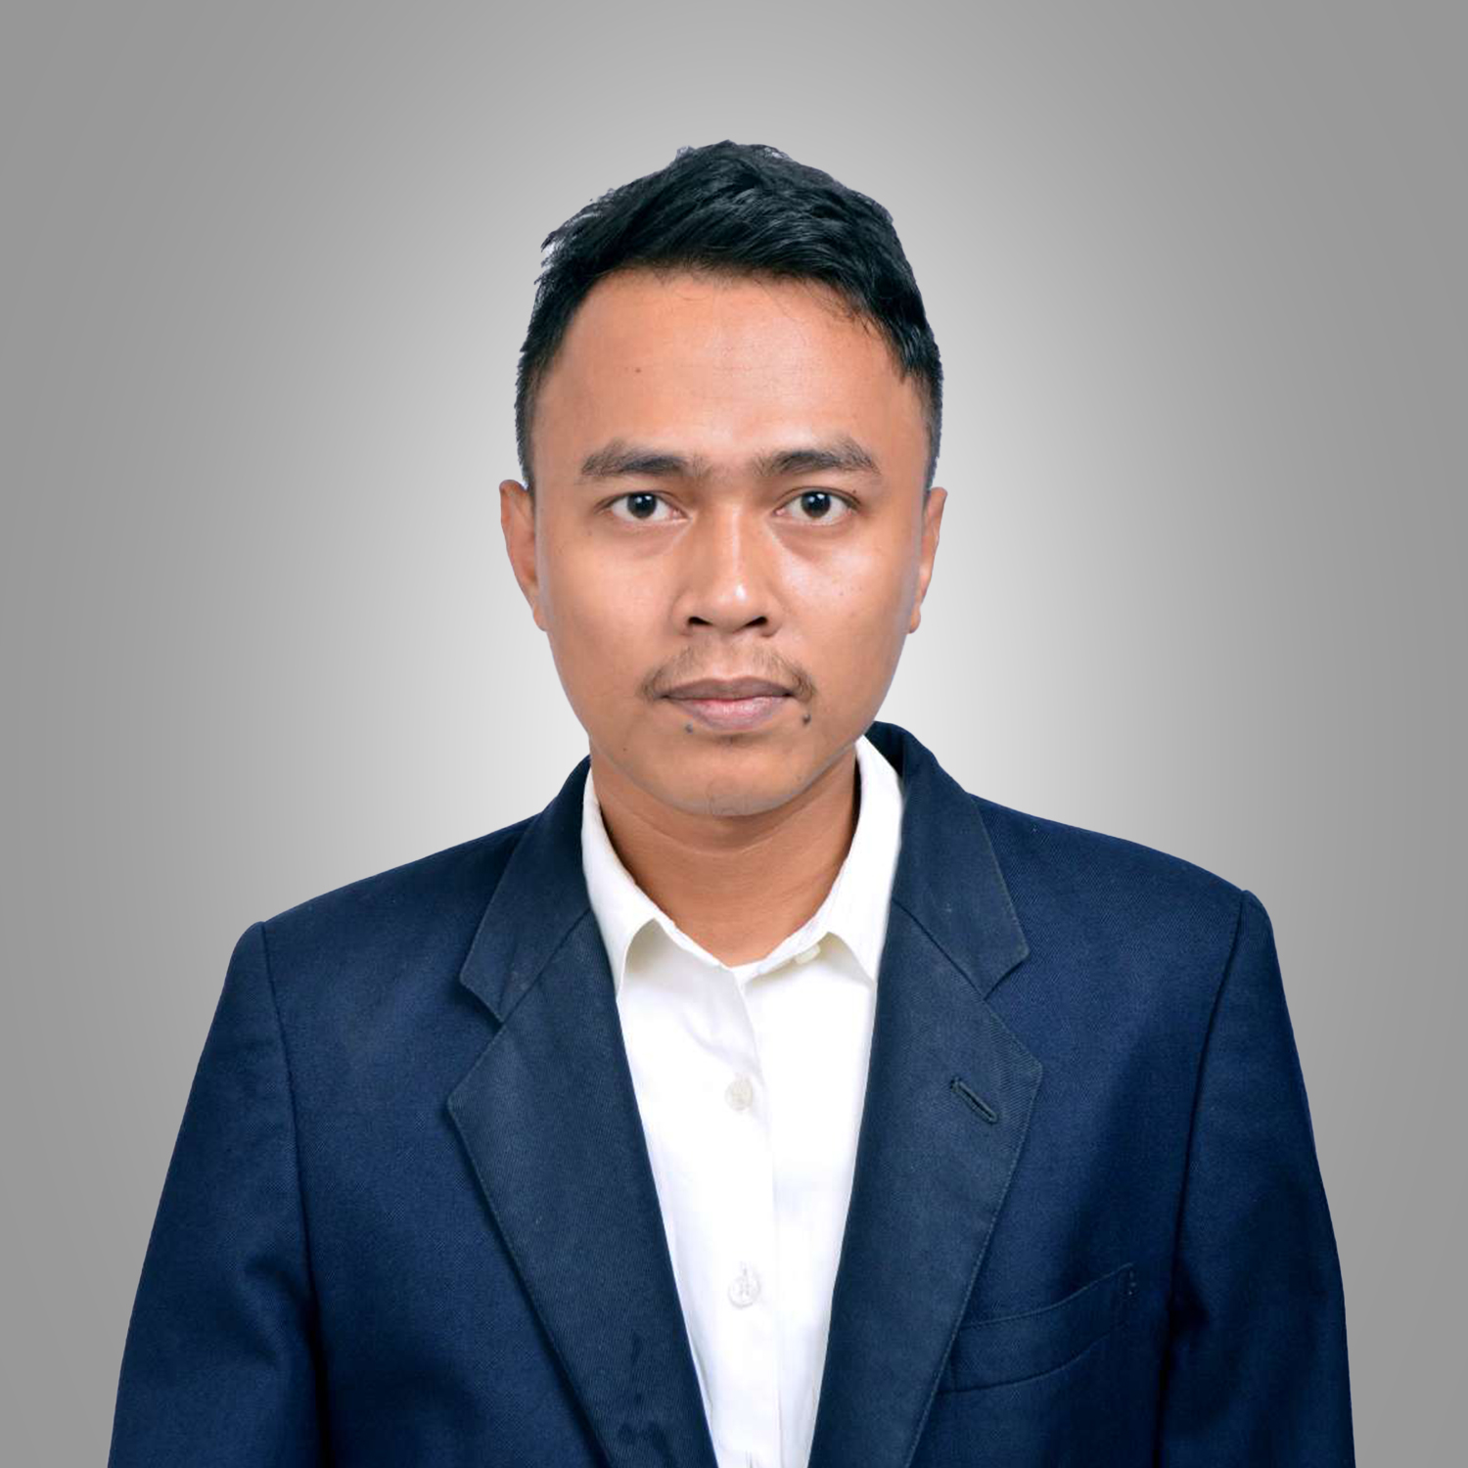
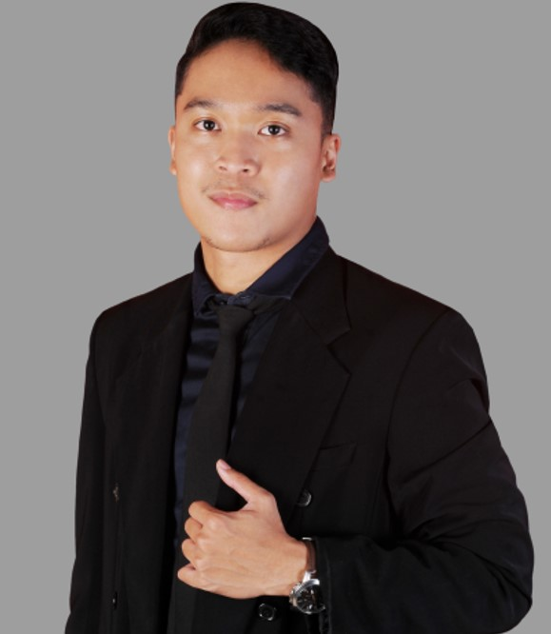
Our Strong Team
Our Manager
Has managing team experience since 2015, has been in a finance company since 2013, joined the fintech industry since 2019, has an AFPI certificate for supervisory skills, Member of AFPI taks force “Penagihan Tidak Beretika” and became one of the key members of PT Debito Korporindo Utama
Experienced in fintech collection since 2018, Has a supervisory skill certificate from AFPI, supervises more than 10 collection supervisors at PT Debito Korporindo Utama
Muhammad Fauzi
Yudi Firmansyah
Bussines Head
Collection Manager

Slide 8
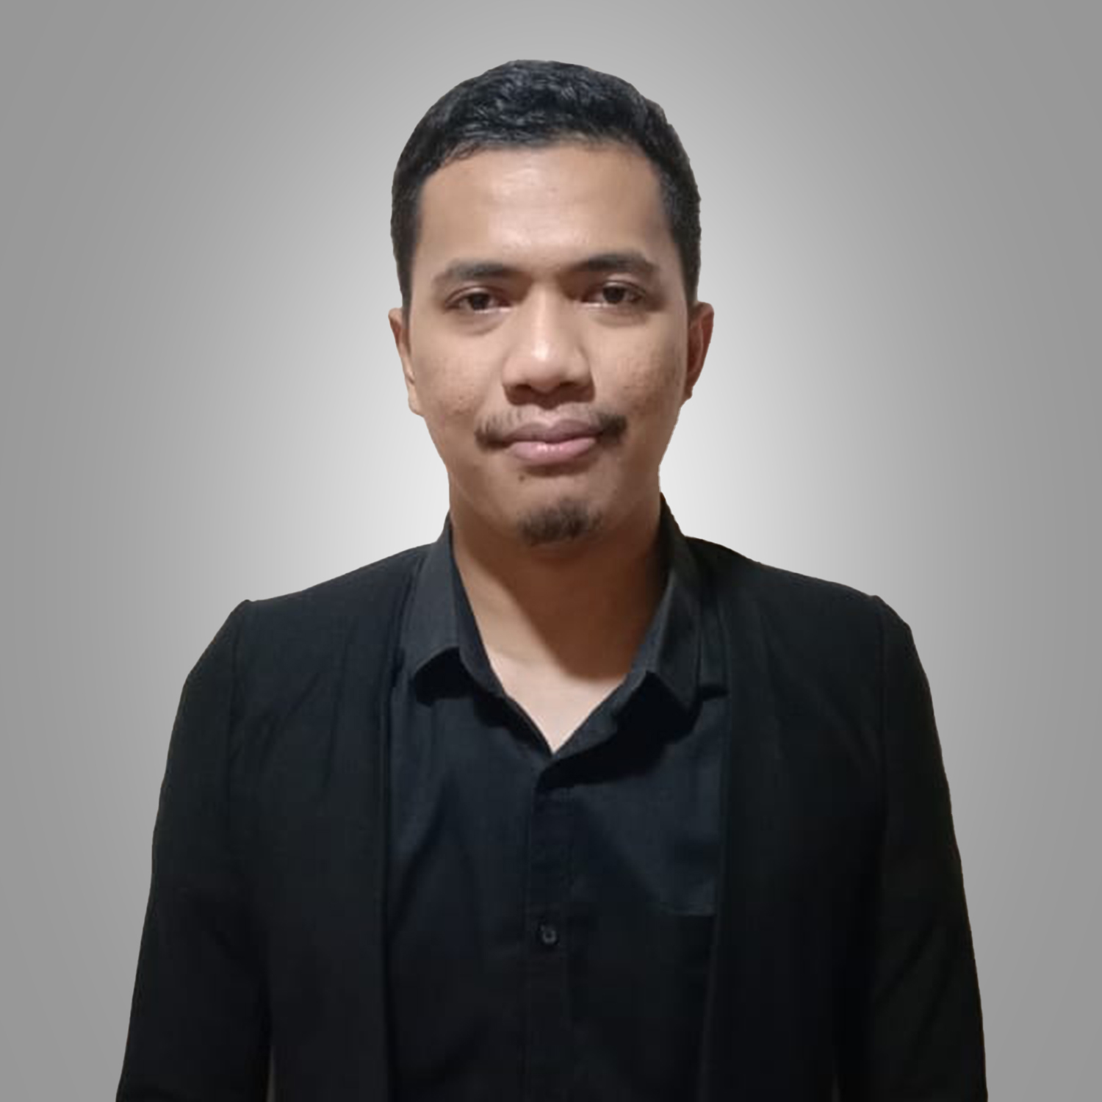
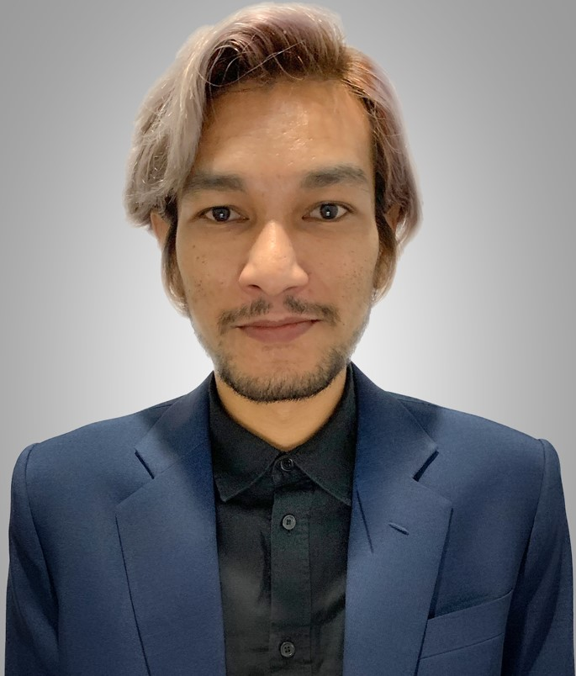
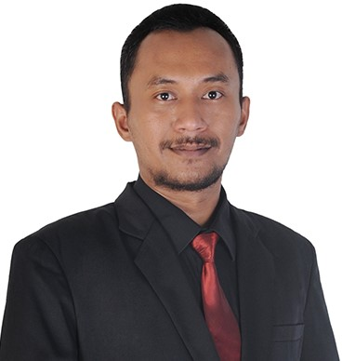
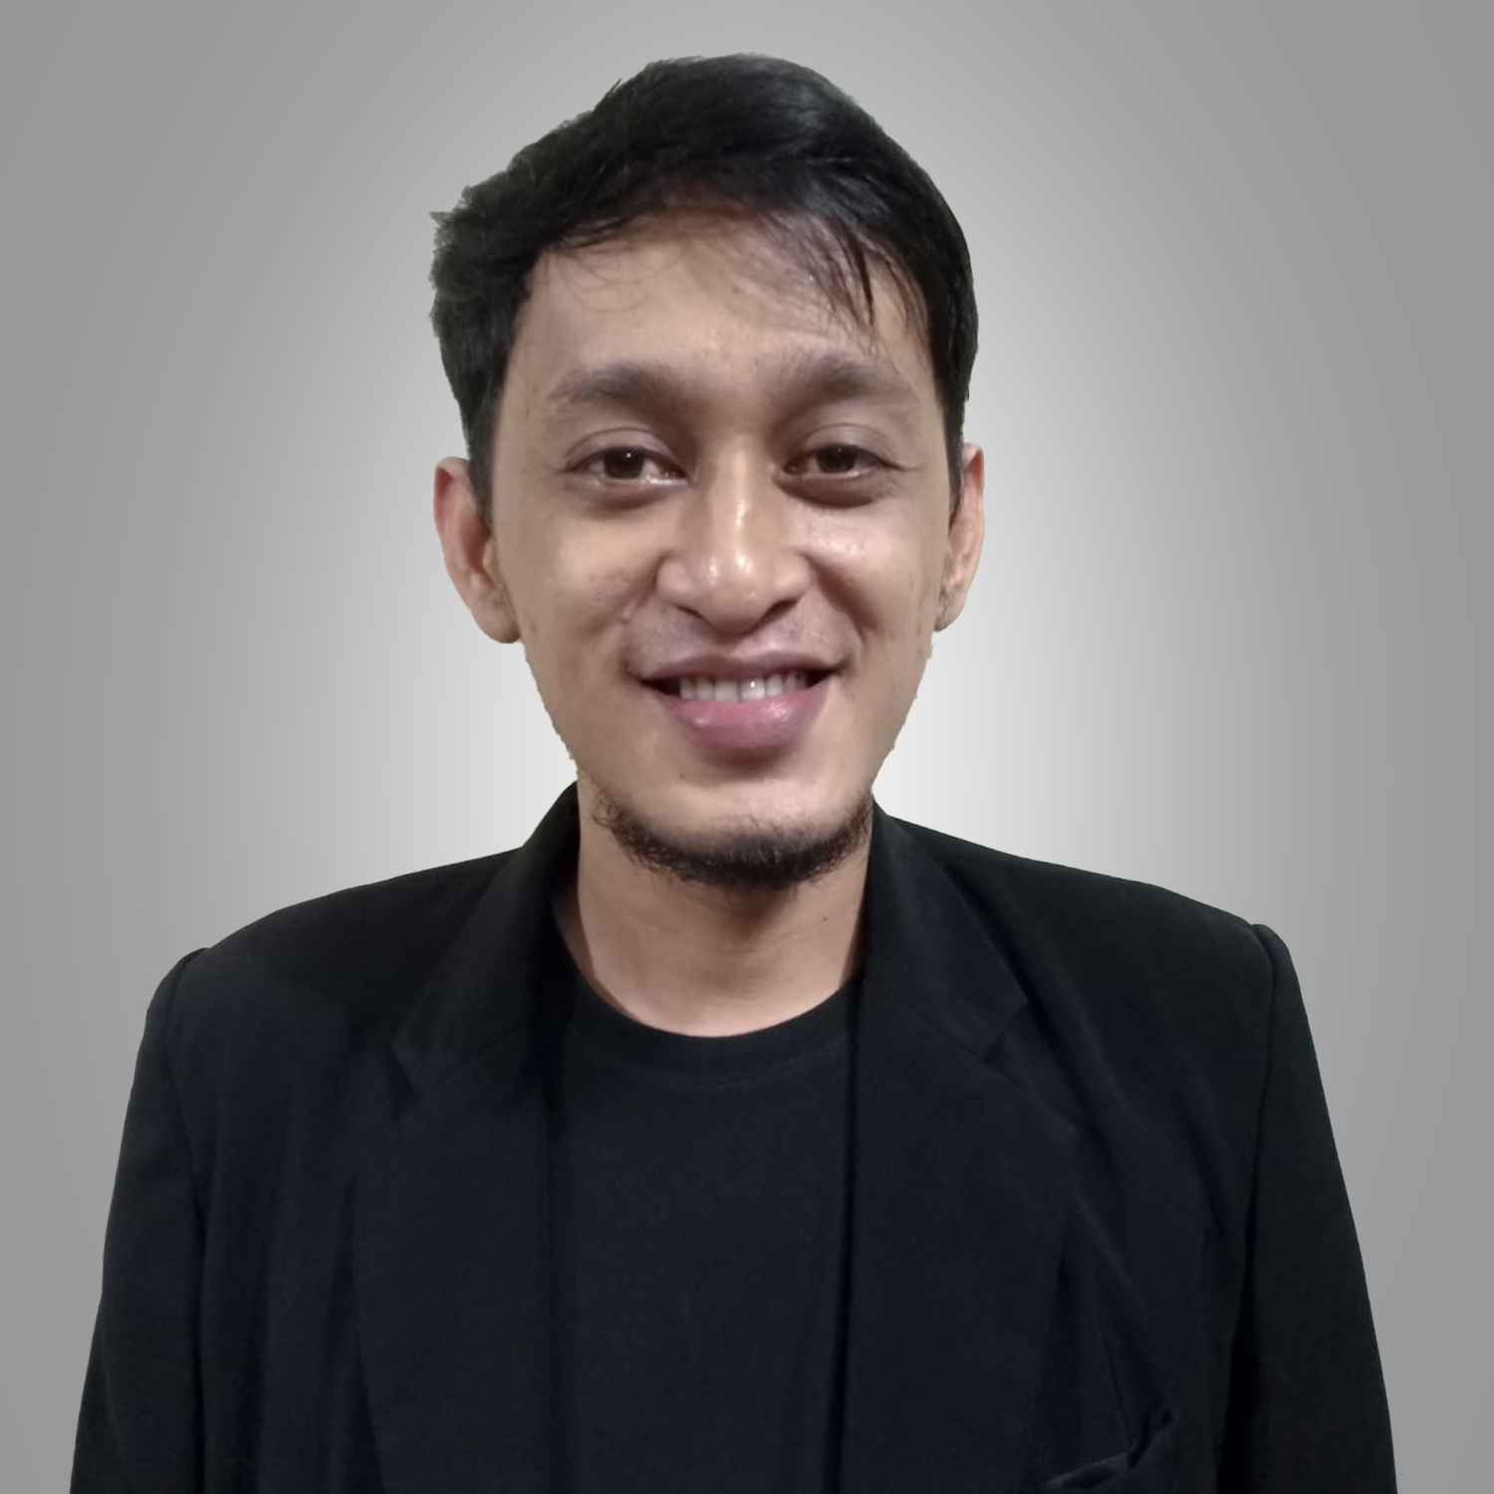
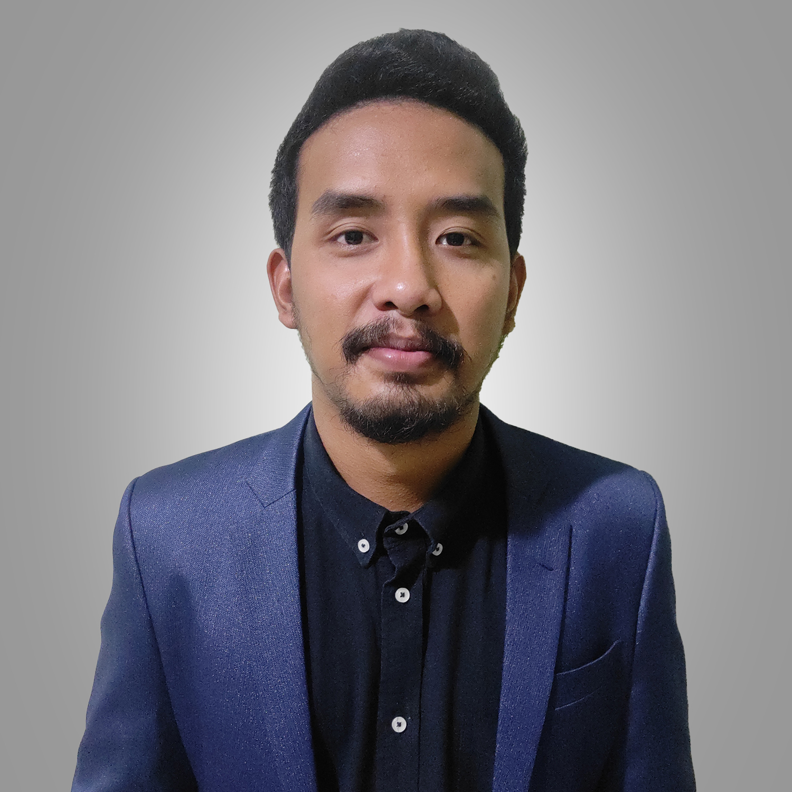
Our Strong Team
Our Supervisor
“Our team formed by more than 191 headcounts which divided to several teams. Each teams will have their own dedicated supervisor which all of them is already certified by AFPI. We also having continious training in monthly basis to adapt new rules from association & regulators”

Slide 9
02 Technology
Advanced Collection System

Slide 10





Smart Technology Sistem
High Efficiency Sistem
Smart Sistem
High Secured Data Management
Read your current connected rate data, Give more experience on your analyse problem
High Efficiency on Contacted Customer Phone & Whatsapp
With encrypted sistem we track all data prossess
We use a automatic dialer & Automatic whatsapp sender, To make 10X efficiency on handling customer
We record every single of our prosses,Example : Phone recording, Whatsapp messages, And also the result of the contacted customer with sistem remarks
Our sistem disbursed your data with risk strategy, Every data has one owner, So that makes your data will be high secured and safe

Slide 11
Smart Technology Sistem
Good news is we have the best collection system ever!
Auto-Predictive Calls
(*) It has proved that auto calls could increase 10x of the efficiency,
Our Smart system & Advanced Tech
Paste-Helper (an whatsapp batch sending tools integrated to system)
(*) It will be attract platforms attention since now our paste helper could detect sim card IMEI, so that we could control the compliance
(**) Our paste helper could decrease banned rate from WhatsApp

Slide 12
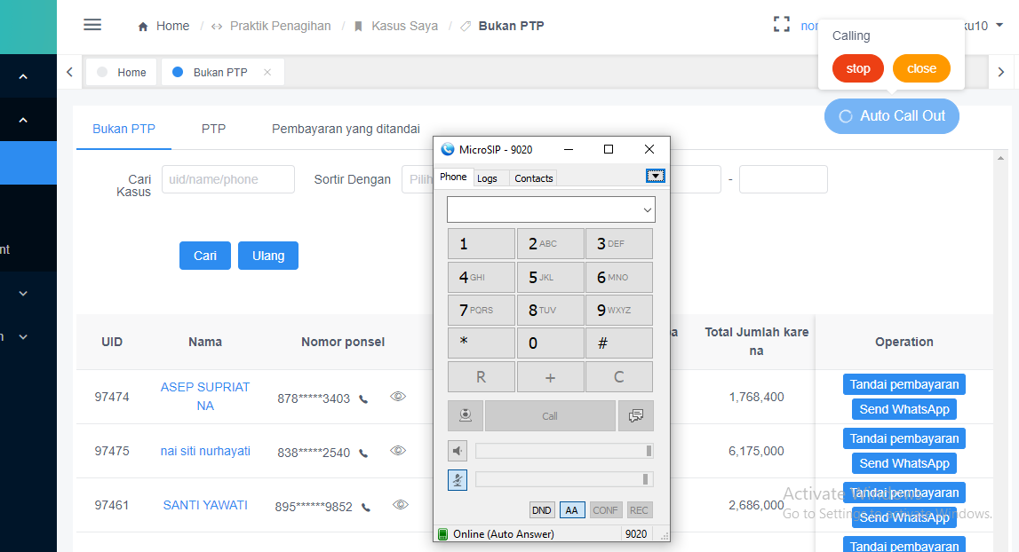

Smart Technology Sistem
Auto-Predictive Calls
Auto Call System Description :
Automatic Phone Number Calling By System
Auto Dial Step:
- Agent Set Auto Call On
- System Start Call The Data
- Answered Data Will Be Pop Up
- Agent Communicate with Customer

Slide 13

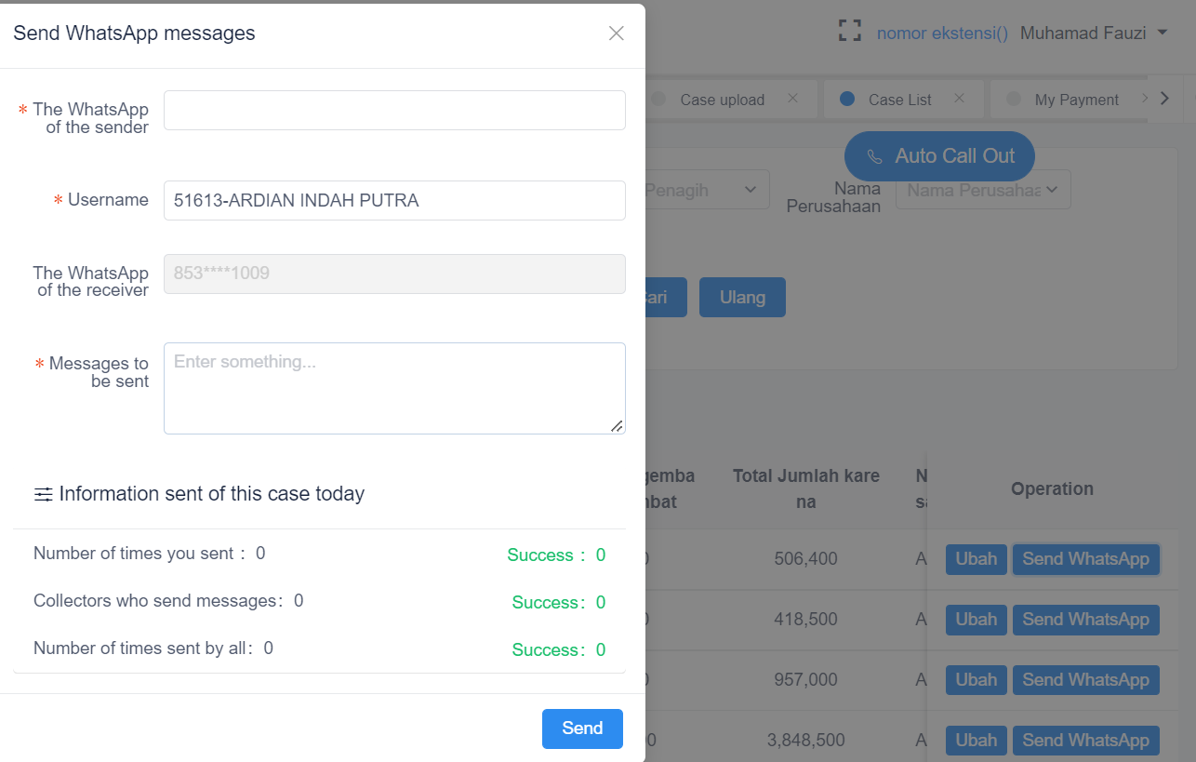
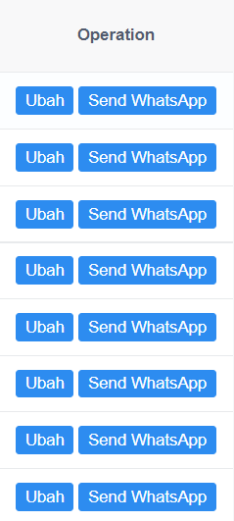
Smart Technology Sistem
Paste-Helper
Paste Helper System Description :
Automatic Whatsapp Messages send By System
Paste Helper Step:
- Agent Use Whatsapp Send Menu At System
- System Send Message To Customer
- Replying Messages will be pop up at agent Phone
- Agent Communicate with Customer By Whatsapp At Their Phone

Slide 14
Data Security
Excel Data :
Client System :
Received Data From Client By Using Encrypted Email
System Integration
Upload To System
Data Disbursed To Dedicated Agent
System Disbursed To Dedicated Agent
Agent Do Collection
Team Leader Do Analyst Then Report the Progress & Result To Spv
Agent Do Collection
Team Leader Do Analyst Then Report The Progress & Result To Spv
SPV Report To Client
SPV Report To Client

Slide 15
03 Strategy
Performance & Complaince

Slide 16

Performance Boost
We are really care and focused on or performance!
To make it realistic, we have:
Performance Improvement Plan (PIP)
Each agents will have their own PIP ranged 30 days
If they are failed to reach their goals, they will get punished by Warning Letter

Slide 17
Complaince Strategy
Anti Trap Rules
Now more and more borrowers intend to make our collectors angry by insulting bad words, in fact, they are just setting a trap and taking bad words from our collectors and reporting them to OJK or AFPI. So, in order to avoid unnecessary trouble to our Clients, we would like to set up the following Debito Anti-Trap Mechanism.
Prohibited Category
Threatening & Swearing
Harsh or insulting words
Religion
Racism

Slide 18
Complaince; Recording Based
Whatsapp Record & Track
admin_name | admin_phone | user_name | user_phone | push_time | brand_model | content
 |  |  |  | 2022-04-12 08:47:02 | Redmi M2006C3LG | Pagi
 |  |  |  | 2022-04-12 08:47:08 | Redmi M2006C3LG | Dengan siapa?
 |  |  |  | 2022-04-12 08:54:01 | Redmi M2006C3LG | Baik pak, nnt konfirmasi lg aja ya pak ke saya. Moga2 dana nya ada secepatnya ya pak
 |  |  |  | 2022-04-12 09:05:21 | Redmi M2006C3LG | Ibu kenapa tidak dibayarkan kemaren
 |  |  |  | 2022-04-12 09:05:28 | Redmi M2006C3LG | Pagi bu
 |  |  |  | 2022-04-12 09:08:54 | Redmi M2006C3LG | Kenapa masih ada kendala dengan dana bu?
Our Whatsapp system track :
- Agent who send the messages
- Customer who received the messages
- Content that our agent send to customer
- Handphone Brand
- Message delivery time
Advantages :
With this whatsapp record we can minimize the number of complaints by taking action early when findings are obtained and before customers make a complaints

Slide 19
Complaince; Recording Based
Daily Phone Recording
user id | Qc Name | Inspection note | user phone | Agent Name
94002 | Eny Sulistiowati | ada komunikasi 2 arah, intonasi jelas, probing jelas, greetig bagus, tapi pada saat dc sedang probing, telp terputus | 081******8947 | Fanny Rahmasari
91841 | Eny Sulistiowati | mailbox | 085******2039 | Fanny Rahmasari
132755 | Eny Sulistiowati | Mailbox | 085******2569 | Fanny Rahmasari
61313 | Eny Sulistiowati | greeting bagus, intonasi jelas, tapi pada saat dc sedang probing, ch lsg cut telp nya | 085******1112 | Fanny Rahmasari
95768 | Eny Sulistiowati | ch sdh respon telp (halo halo) tapi dc tdk merespon | 085******9724 | Fanny Rahmasari
Our Recording system track :
- Agent who Call the customer
- Content of the conversation between the agent and the customer
- Call Time & Duration
Advantages :
With this Recording we have 2 advantages :
1. Same as whatsapp we can take early action for the complaints
2. we can assess the quality of collection agent in communicating with customer

Slide 20
04 Services
We are providing a better solution with reachable price

Slide 21

Our process to handle your data
ALL PROCESS WILL BE DONE IN 2 WEEKS!*
2
4
Data Sending & Syncronization
1
3
GO LIVE!
Partnership Agreements
Agent Training
3 Days after contract signing

Slide 22
05 Our Office
We are providing a convinient office spaces for our agents to support their performance

Slide 23
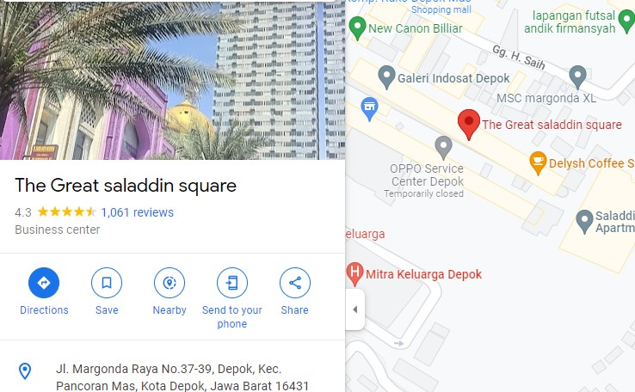



Strategic Location
Ruko Saladin Square Blok B3
Jl. Margonda Raya No.37-39, Depok, Kec. Pancoran Mas, Kota Depok, Jawa Barat 16431
(021) 5064-5087
Info@debitokorp.com
0889-7678-3368

Slide 24
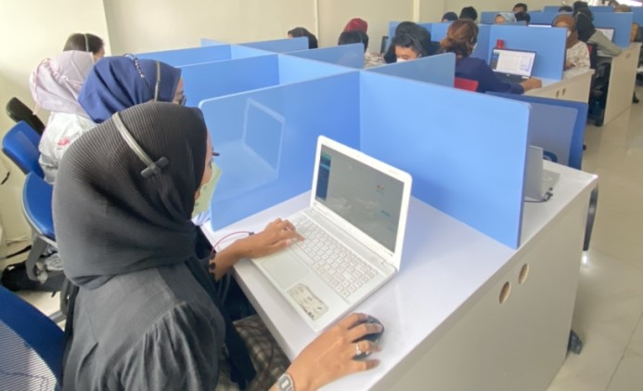
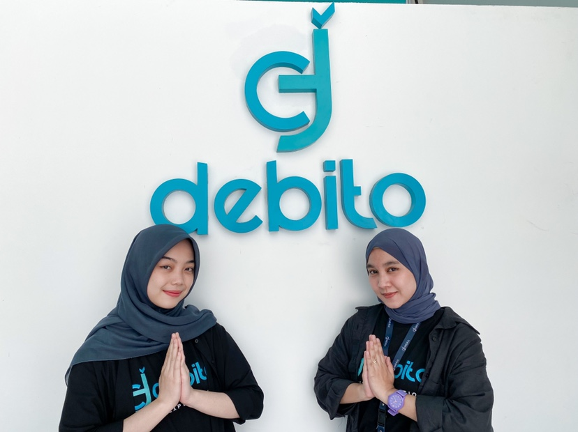
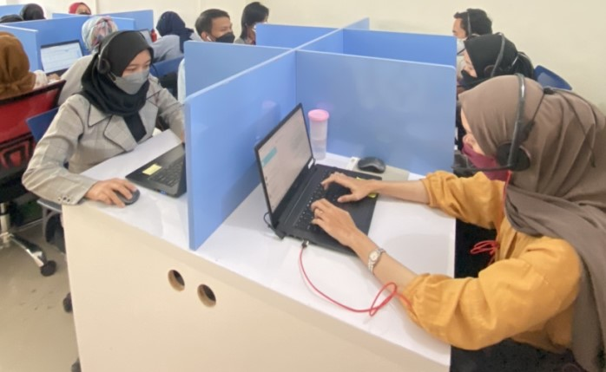
Our Office Views
A dedicated cubicles and working asset for each agents to enhance the collection performance

Slide 25












Our Client

Slide 26
THANK YOU

